Slide 1

Created By: Ryan Bury, Ethan Raymond, Connor Dougherty, Jake Deshaies, and Collin DeMatt

Slide 2
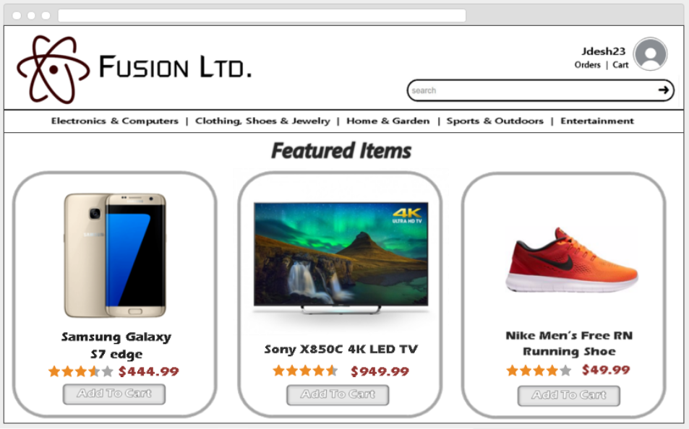

Slide 3


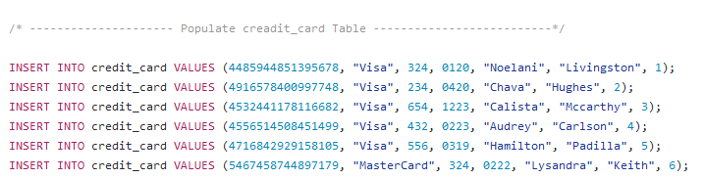
Populating the Database:
Gathering data:
Randomly generated user info including their username, address and credit card info using a few data generator sites.
Found data pertaining to suppliers and items on popular websites such as amazon and ebay.
Entering data into tables:
Wrote python scripts to generate the SQL queries needed to insert the data into the tables of our database.

Slide 4
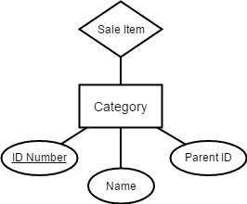
We Translated Our Concepts and ER Diagrams into working SQL Statements
CREATE TABLE Categories (
id integer NOT NULL,
name varchar(50) NOT NULL,
parentID integer,
PRIMARY KEY (id)
);

Slide 5
SQL Schema Refinement: Supplier
Supplier(supplier_id, company_name, password, point_of_contact, email, phone, address, category, yearly_revenue, url_ext, banner, about)
Supplier(supplier_id, company_name, url_ext, password, category, yearly_revenue, banner, about)
Contact_Info(point_of_contact, supplier_id, email, phone, address)

Slide 6
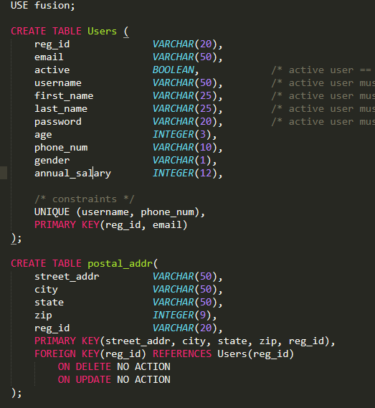
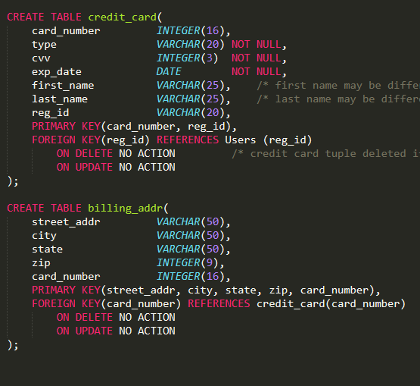
SQL Schema Refinement: Registered Users

Slide 7
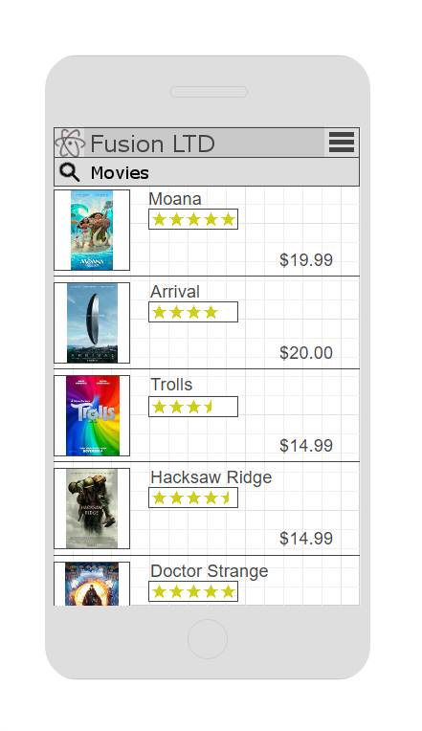
Mobile Application
Ease of Use
Profound Simplicity
Mobile Capability
More Purchases

Slide 8
Conclusion
Impact of Technology
Refine Group Workflow
Simplicity is our Goal
Thorough Analysis of Design Implementation

